Slide 1
Weather Station
CS 435 Embedded Systems
By Atika Singh, Brandon Rasgaitis, Gabriel Eller

Slide 2
General Idea
IoT application
Measures physical parameters such as temperature, humidity, and air pressure
Sends the data measured to the Cayenne Cloud using MQTT network protocol.
Displays data in a GUI provided by Cayenne for developers

Slide 3
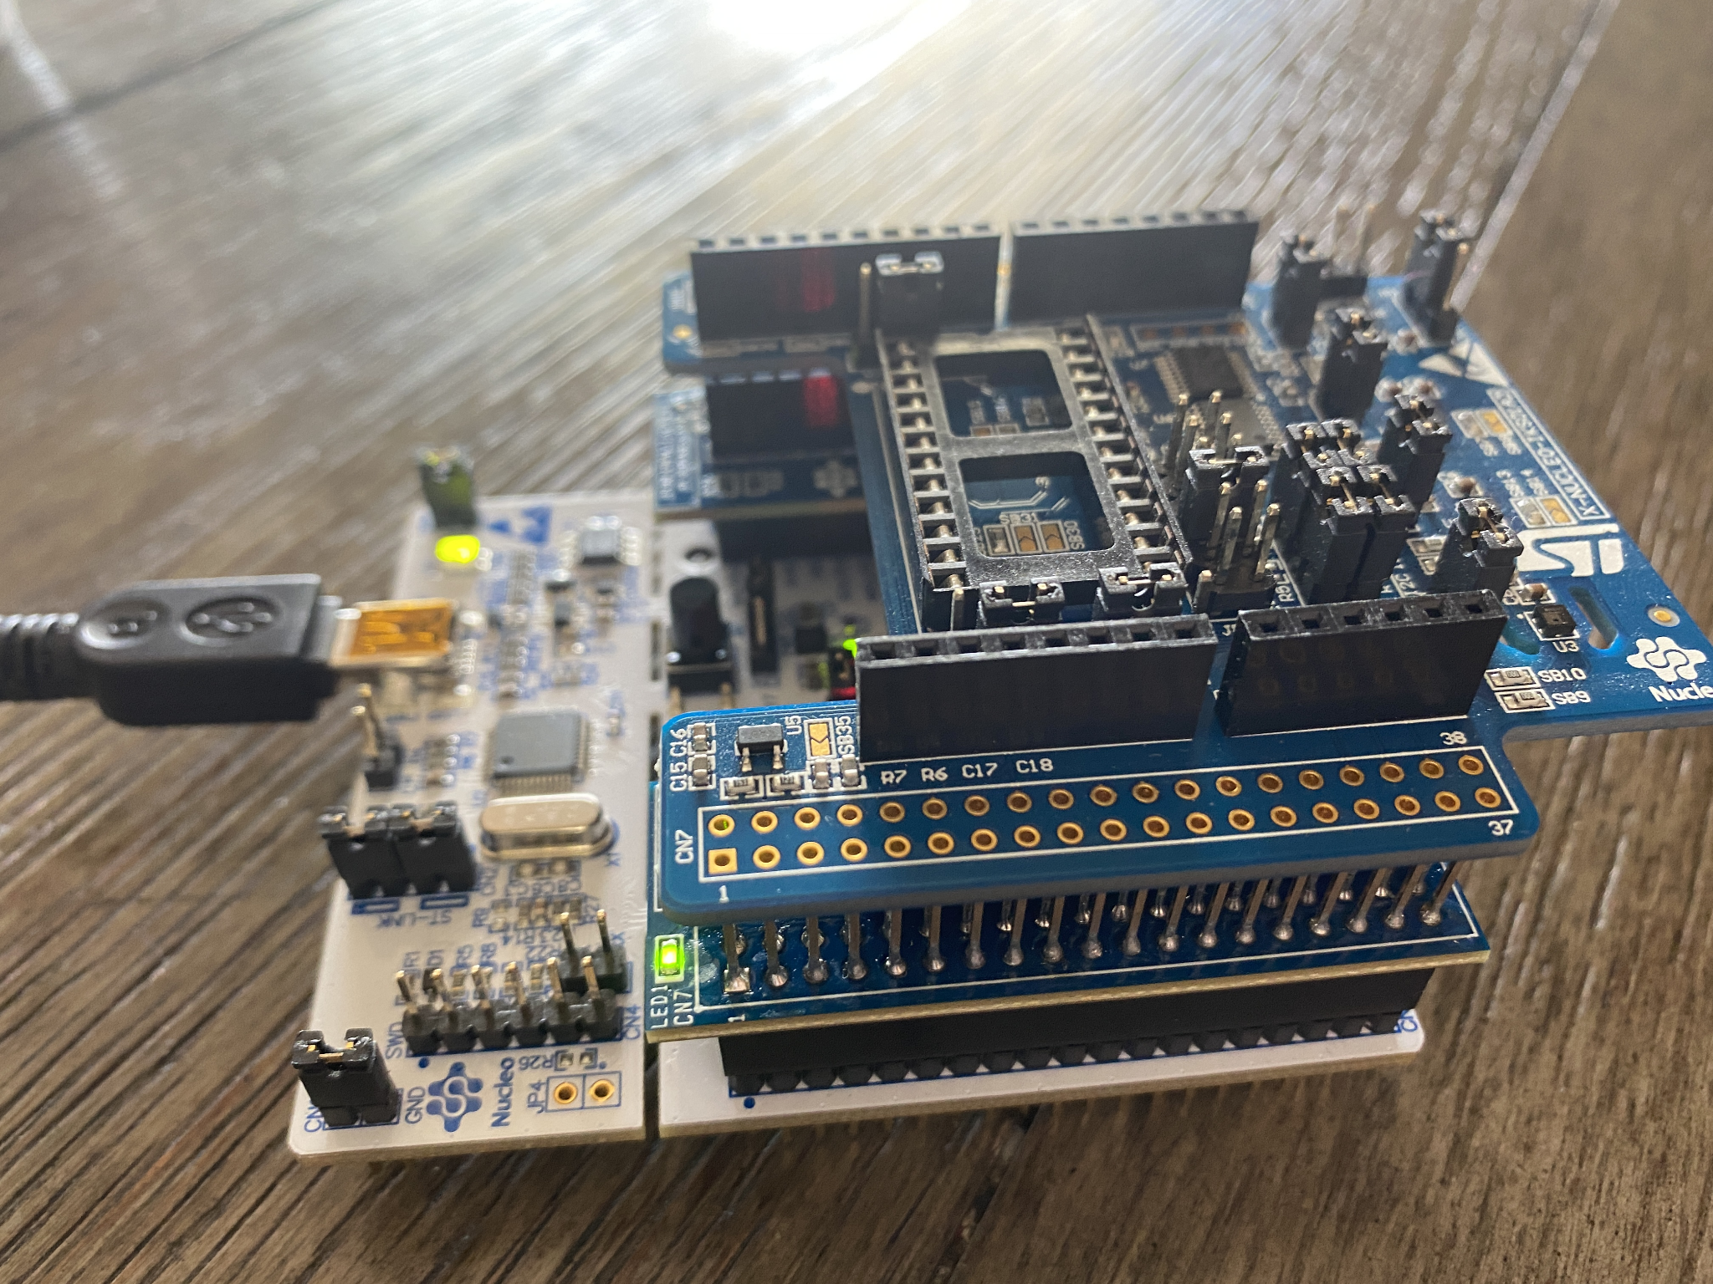
Hardware Used
Nucleo Board F401RE
Wifi expansion board: X-Nucleo-IDW01M1
MEMS sensor: X-NUCLEO-IKS01A2

Slide 4
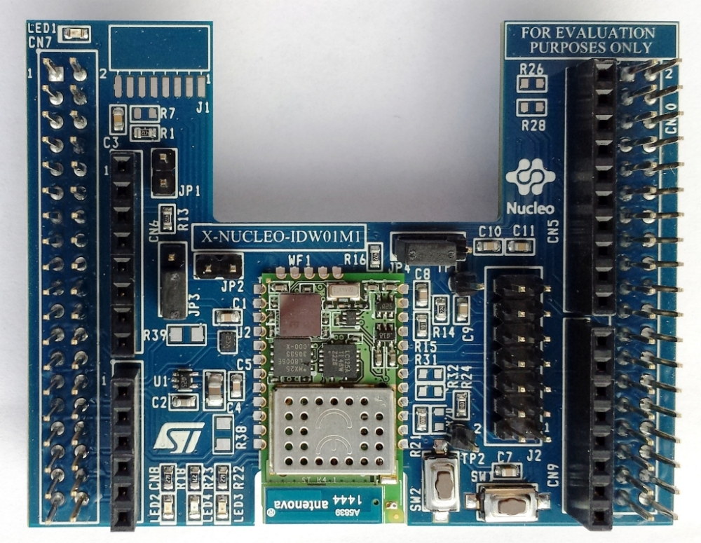
X-NUCLEO-IDW01M1 Wi-Fi Expansion Board
Facilitates communication between device and the Cayenne cloud
UART serial connection
8 TLS/SSL encrypted TCP channels for secure data transfer

Slide 5
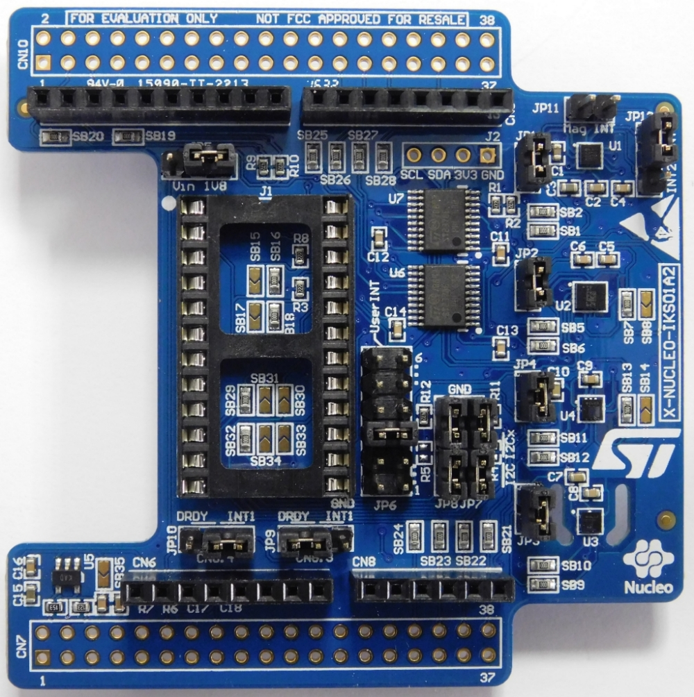
X-NUCLEO-IKS01A2 MEMS and Environmental Sensor Expansion Board
Handles real-time capturing of climatic metrics
I²C bus connection
Humidity and temperature sensors
Digital barometer to measure air pressure
3-axis gyroscope, accelerometer, and magnetometer (not implemented in Weather Station, but very powerful tools nonetheless)

Slide 6

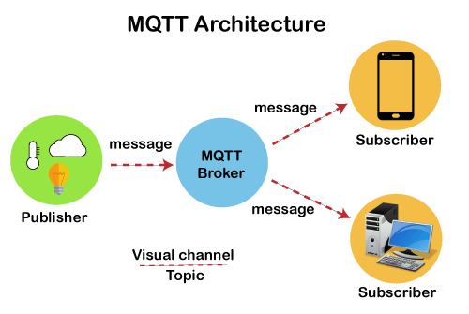
Software Used
Cayenne Cloud
Cayenne MQTT API: Network Protocol

Slide 7
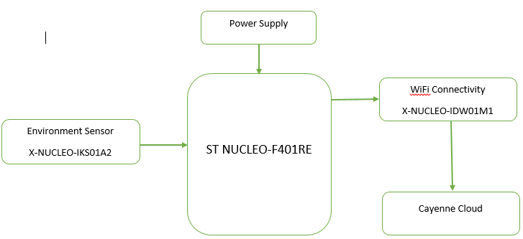
Diagrams
BLOCK DIAGRAM
Fig: Block Diagram of system Overview

Slide 8
Code
Pseudo code:
PDL
BEGIN
Instantiate and enable all required sensors from the MEMS expansion board
Instantiate Wifi expansion board
Enter Wifi SSID and password
Connect to wifi
Instantiate connection to cayenne server
Enter the Username, password and client ID for cayenne
Establish a connection with Cayenne.
Return Success if connection established, else return “connection failure”
Subscribe to 3 different channels for temperature, humidity and pressure.
DO FOREVER:
Set the MQTT timer to collect data after every 3 seconds.
Check if we are still connected to the network.
Reconnect if required
Read data in three different variables (temperature, pressure and humidity) from
MEMS sensor
Publish this data to the 3 channels previously established.
Repeat after every 3 seconds
ENDDO
END

Slide 9
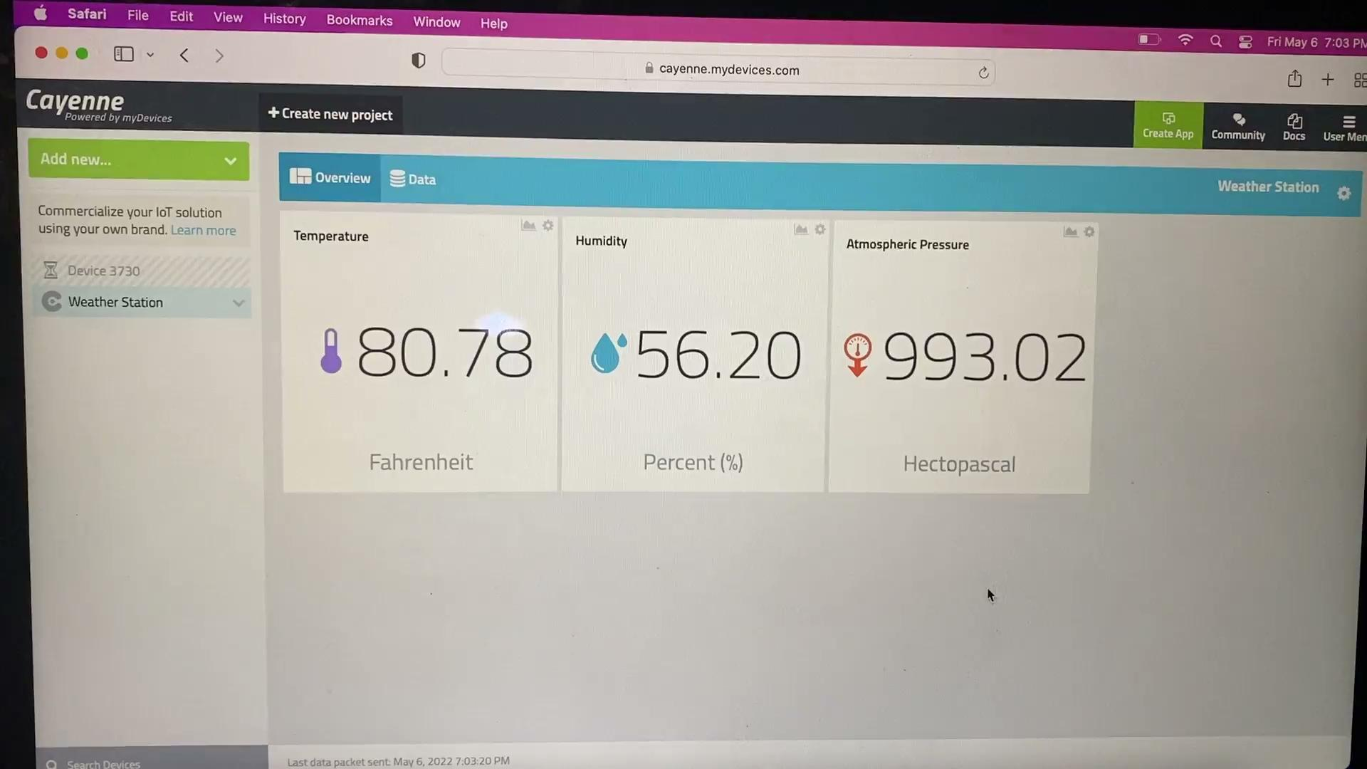
Results

Slide 10
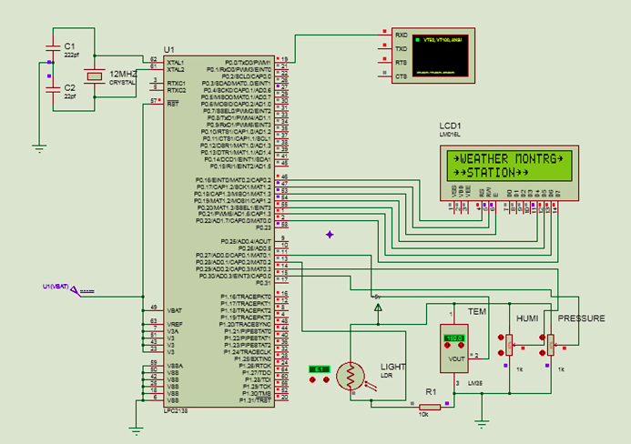
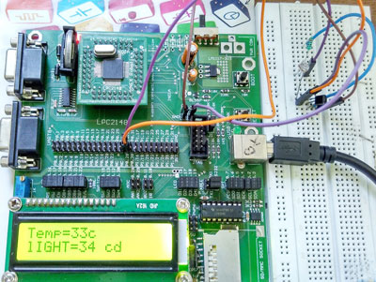
Similar Works
Weather Monitoring Station
By https://www.mepits.com/index.php/site/viewProfile/id/1406
monitor weather parameters such as atmospheric temperature, light intensity, humidity and pressure.
An LCD is used to display the output from MC.
LDR sensors to detect light intensity
RPi mcu over all is a more powerful device
Designed for UI compared to the Nucleo-Board

Slide 11
Tests and Results
Test 1
Test 2: Outside
Test 3: part 1: Gaming Pc temp
Test 3: part 2: Gaming Pc temp results

Slide 12
References
https://www.mepits.com/project/366/embedded-projects/weather-monitoring-station
https://developers.mydevices.com/cayenne/docs/cayenne-mqtt-api/#cayenne-mqtt-api-using-c-code-examples
https://www.st.com/en/ecosystems/x-nucleo-idw01m1.html
https://www.st.com/en/ecosystems/x-nucleo-iks01a2.html

